Slide 1
Automating Build Notifications with AWS CodeBuild Buildspec

Slide 2
Structure of buildspec.yml
version: 0.2
phases:
install:
commands:
- echo "Installing dependencies"
pre_build:
commands:
- echo "Preparing for build"
build:
commands:
- echo "Building the project"
post_build:
commands:
- echo "Build completed"

Slide 3
Using Pre-build and Post-build Phases
pre_build:
commands:
- BUILD_STATE=$CODEBUILD_BUILD_SUCCEEDING
post_build:
commands:
- if [ "$BUILD_STATE" -eq 1 ]; then echo "Success"; else echo "Failure"; fi

Slide 4
Benefits of Using buildspec.yml
Simplified Process
Integrates notification directly into the build lifecycle.
Reduced Complexity: Eliminates need for additional AWS services (like Lambda).
Real-time Updates: Immediate notifications inform stakeholders about build states.

Slide 5
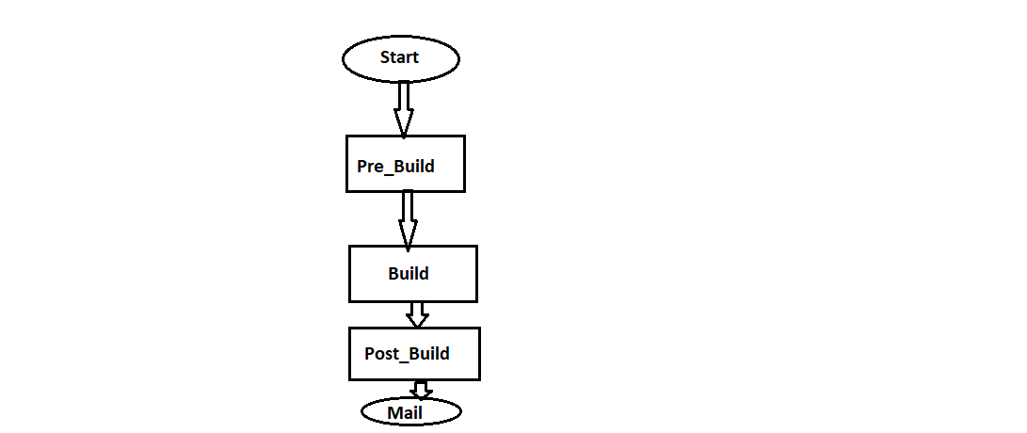
Flowchart

